Slide 1
Developing a Blockchain-Based eVault for Legal Records
PIP4004 University Project
Review-0
Batch Number: CSE_CST_17
Under the Supervision of,
Prof. Shaik Salma Begum
School of Computer Science and Engineering
Presidency University
Roll Number | Student Name
20211CST0006 | Nagaruru Sunandhan
20211CST0039 | Bobbiti Yaswanth Reddy
20211CST0041 | Kruthika S
Name of the Program: BTech
Name of the HoD: Dr. Saira Banu
Name of the Program Project Coordinator: Dr. H M Manjula
Name of the School Project Coordinators: Dr. Abdul Khadar A

Slide 2
Content
Problem Statement
Github Link
Literature Review
Analysis of Problem Statement
Timeline of the Project
References

Slide 3
Problem Statement Number: PSCS_7
Organization: Ministry of Law and Justice
Category : Software
Problem Description:
In the current centralized system, legal documents are vulnerable to manipulation by administrators and susceptible to cyber-attacks leading to data loss or compromise. These issues undermine the reliability and trustworthiness of legal records, posing significant challenges to the legal system. Furthermore, the lack of direct methods to detect alterations exacerbates concerns regarding the authenticity and integrity of documents. Addressing these challenges is paramount to maintaining the credibility and effectiveness of legal proceedings
Difficulty Level: Simple

Slide 4
Github Link
https://github.com/nanda898/Developing-a-Blockchain-Based-eVault-for-Legal-Records

Slide 5
Literature Review
NyaYa: Blockchain-based Electronic Law Record Management Scheme for Judicial Investigations Pronaya Bhattacharya, Deepti Saraswat, Sudeep Tanwar (2021).
Blockchain Technology for Secure and Transparent Legal Record Management Satoshi Nakamoto (2008).
Smart Contracts for Access Control and Permissions in Blockchain Systems Vitalik Buterin (2014).
User-Friendly Interfaces for Blockchain Applications Mougayar W (2016).
Interoperability of Blockchain Systems with Existing Databases Cachin C & Vukolic M (2017).
Recordism: A Social-Scientific Prospect of Blockchain from Social, Legal, Financial, and Technological Perspectives Zihao Li, Hao Xu, Yang Fang, Boyuan Zhao, Lei Zhang (2022).

Slide 6
Analysis of Problem Statement
The legal sector relies heavily on document management, with records such as contracts, case files, affidavits, judgments, and agreements requiring high security, transparency, and accessibility. However, traditional legal record-keeping systems suffer from the following key issues:
1.1 Security and Data Integrity Risks
Centralized databases are prone to cyberattacks, unauthorized modifications, and data breaches.
Lack of robust encryption mechanisms makes sensitive legal documents vulnerable to theft or tampering.
Insider threats and fraudulent document alterations can compromise the judicial process.
1.2 Lack of Transparency and Trust
There is no tamper-proof audit trail in traditional systems, making it difficult to verify document authenticity.
Stakeholders (lawyers, clients, and judges) often face delays in retrieving legal records due to inefficiencies in document management.
Disputes over document versions or unauthorized modifications can lead to legal conflicts.

Slide 7
Analysis of Problem Statement (contd...)
1.3 Limited Accessibility and Interoperability
Legal records are often stored in isolated, jurisdiction-specific databases, making information exchange between courts and law firms challenging.
Clients and lawyers struggle to retrieve and verify legal documents remotely due to a lack of digitization and automation.
The integration of existing case management systems with new technologies is complex and costly.
1.4 High Costs and Inefficiencies
The manual handling of legal documents increases administrative costs and processing time.
Verification processes require significant human intervention, leading to delays in court proceedings.
Storage, retrieval, and authentication involve high operational expenses for courts and legal institutions.

Slide 8
Analysis of Problem Statement (contd...)
Objective:
The objective of this project is to leverage blockchain technology for the management of legal and criminal documents. By migrating to a blockchain-based system, the aim is to enhance data security, ensure tamper-proof records, facilitate easy verification, and provide decentralized storage. This shift will mitigate the risks associated with centralized servers, such as unauthorized alterations and cyber-attacks, thus ensuring the integrity and availability of critical legal information.

Slide 9
Analysis of Problem Statement (contd...)
PROPOSED SYSTEM:
A blockchain-based eVault offers a decentralized, secure, and efficient way to store, manage, and share legal records. The proposed solution should address the above challenges through the following features:
Security and Data Integrity
Transparency and Trust
Improved Accessibility and Interoperability
Role-based access control (RBAC).
Integration with existing legal databases.
Cost Reduction and Efficiency Gains

Slide 10
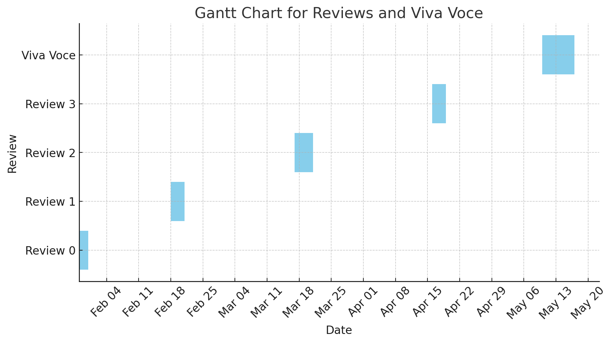
Timeline of the Project (Gantt Chart)

Slide 11
References (IEEE Paper format)
https://www.researchgate.net/publication/354599955_NyaYa_Blockchain-based_Electronic_Law_Record_Management_Scheme_for_Judicial_Investigations
https://ethereum.org/en/whitepaper/
https://arxiv.org/abs/2204.00823?utm_source=chatgpt.com
https://arxiv.org/pdf/1707.01873
https://bitcoin.org/bitcoin.pdf
https://dl.acm.org/doi/fullHtml/10.1145/3675888.3676140?utm_source=chatgpt.com
https://ieeexplore.ieee.org/abstract/document/10574924
https://pubs.aip.org/aip/acp/article-abstract/3214/1/020051/3318716/Blockchain-based-evault-for-legal-records-A

Slide 12


